Slide 1
Local Government Networking and Information Sharing Event
Large Scale Stormwater Harvesting and Treatment Assets
14 May 2025

Slide 2
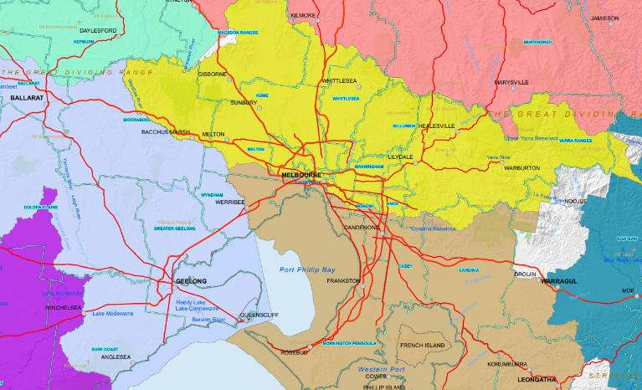
Acknowledgement of Country
Melbourne Water respectfully acknowledges the Wurundjeri Woi-wurrung peoples as the Traditional Owners and Custodians of the land and water on which we meet today.
We pay our deepest respects to their Elders past, present and emerging.
Wurundjeri Woi-wurrung
Wadawurrung
Bunurong

Slide 3
Housekeeping
When leaving, please have a Melbourne Water person with you, and return name badge to reception

Slide 4
Agenda
Now | Melbourne Water and Clearwater Introduction
10.20 am | 2024 Stormwater Harvesting Condition Audit | Melbourne Water
10.45 am | Break
11.00 am | Greater Western Water Stormwater Harvesting Partnerships | Sam Innes
11.35 am | City of Casey Stormwater Harvesting Case Studies | Nausheen Obaid and Priya Ravikumar
12.05 pm | Clearwater and Melbourne Water Info Update + Feedback Survey
12.10 pm | Lunch
12.40 pm | Informal networking/information sharing/workshop
1.20 pm | End

Slide 5
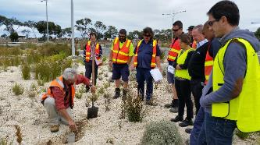
About Clearwater
Building capacity for integrated water management since 2002
Our goal
Develop skills, share knowledge and build networks
Our support
Training, tours, and networking events
Free online resource library
We are hosted and funded by Melbourne Water and receive project funding from DEECA.

Slide 6
What’s on
Upcoming training & events
Bioretention 101: Stormwater Victoria 2025 Pre-Conference Workshop (Wangaratta), registrations open
Regional Victoria water sensitive urban design (WSUD) maintenance training: being scheduled for 2025 delivery across Victoria
Stormwater Management Foundations: 4-part course run online with Institute of Public Works Engineers Australasia (August 2025), registrations open
To stay up-to-date
Subscribe to our e-news mailing list
Connect with us on LinkedIn

Slide 7
What’s on
In development
Partnering with DEECA:
Stormwater Offsets Scheme Guidance Webinar (June 2025)
Victorian IWM Webinar Series (later in 2025)
Partnering with Melbourne Water:
Stormwater Harvesting and Infiltration Flow Targets guidance (later in 2025)
Upcoming resources
Case studies: new case studies this year – get in touch if you’d like to feature a project
Videos: watch this space for exciting new video interviews!
To stay up-to-date
Subscribe to our e-news mailing list
Connect with us on LinkedIn

Slide 8
2024 Stormwater Harvesting and Wetland Condition Audit
Background
Method
Results
Recommendations

Slide 9
2024 Stormwater Harvesting Condition Audit
Purpose
Understand long-term performance of investments through LCLW stormwater incentives/Living Rivers
Identify problems in design, construction, maintenance and where we can provide support
Inform proposed asset rectification / renewal funds
Improve on the delivery of future projects

Slide 10
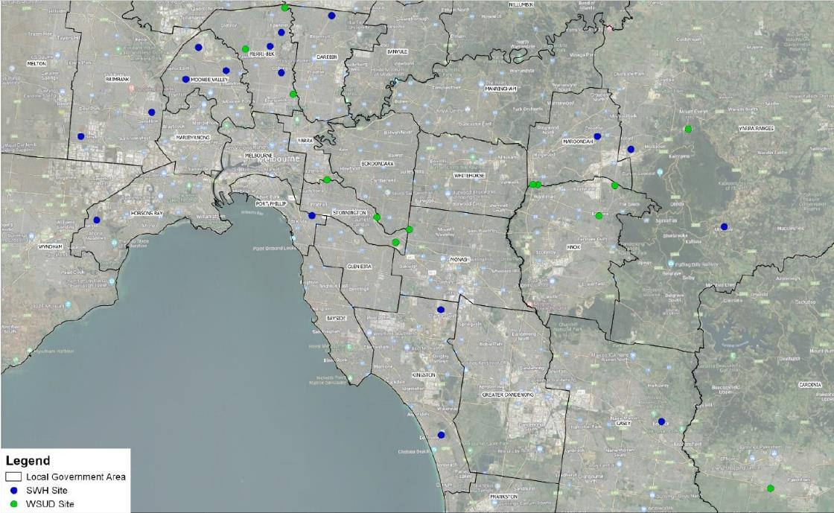
Sites Audited

Slide 11
Method
Design drawing and Music Model review
Audit methodology and framework for WSUD and SWH audits
Email to Council contact to introduce the audit consultant
Stormwater harvesting questionnaire email
Audit Consultant arranges the site visit date
Data collation and review of information relating to WSUD and SWH assets.
Field-based audits of assets supported by the LCLW incentives program and managed and operated by Council’s and water authorities. The audits included observations about what factors resulted in the assets functioning optimally or sub-optimally
Audit summary report

Slide 12
Results - Wetlands
For the 6 wetlands constructed prior to 2017, 3 wetlands had fully blocked inlets, 3 had partially blocked inlets, 4 out of 6 had good macrophyte zone plant cover
For the 7 wetlands constructed since 2017, none had blocked inlets. 6 out of 7 had good macrophyte zone plant cover

Slide 13
Example Result - Wetlands

Slide 14
Results – Stormwater Harvesting
6 out of the 17 audited SWH schemes were not operational at the time of the audit. 4 of the 6 non-operational systems had blockage at the diversion structure inlet pipe
water quality sensors were a significant source of faults and require frequent calibration. The location of the sensors, choice of sensor (product) and the lack of active maintenance of these sensors are likely to be contributing factors in the performance of water quality sensors where they are installed
Stormwater harvesting yields are significantly lower than design/model

Slide 15
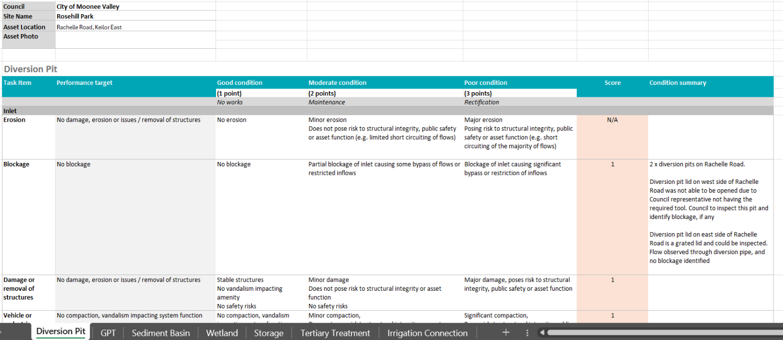
Example Results – Stormwater Harvesting

Slide 16
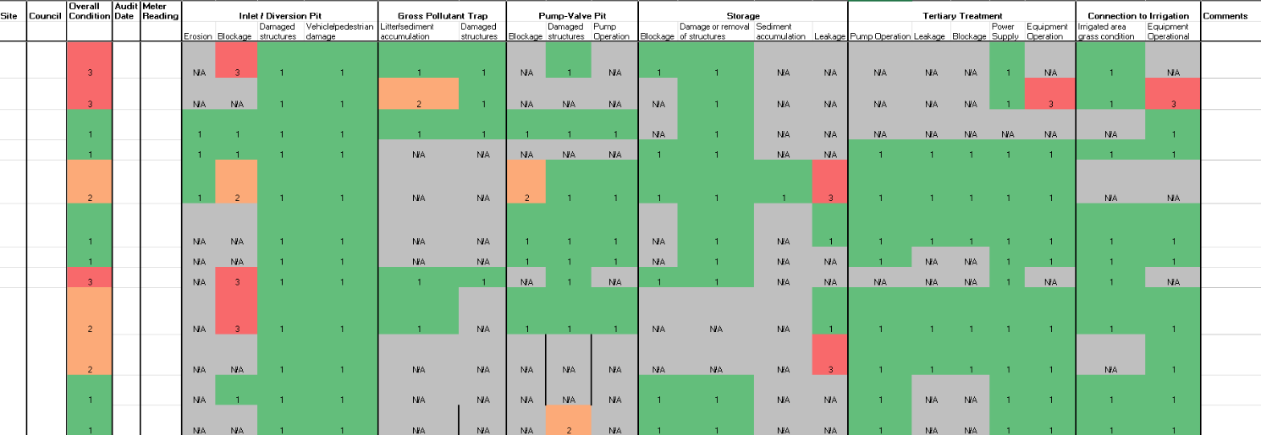
Results – Stormwater Harvesting

Slide 17
Acknowledgement of Success
Moonee Valley
Merri-bek
Darebin
Kingston
Casey
Hobsons Bay
Yarra Ranges

Slide 18
Recommendations
System Functionality (Yield)
Repair defective meters and assess meter locations for potential modifications to enhance accessibility for manual readings.
If required, complete training on water meter usage through Irrigation Australia (www.irrigation.org.au) or another accredited institution.
Designers should position water meters to ensure demand volumes can be directly reported without adjustments for:
Potable water top-ups or other non-stormwater sources.
Non-demand usages such as purging, flushing, or recirculation.
Strengthen reporting and monitoring requirements for potable water usage to support proactive maintenance and improve operational accountability for stormwater harvesting (SWH) systems.

Slide 19
Recommendations
System Functionality (Treatment) Recommendations
Evaluate irrigation area designs and monitoring practices against the National Stormwater Harvesting Guidelines to assess the quality of harvested stormwater for irrigating open spaces. This assessment should include:
Public health and environmental considerations, such as public accessibility.
Real-time water quality monitoring of harvested stormwater.
When designing treatment trains, carefully assess site-specific risks at the catchment scale, such as the presence of unsealed roads, and adjust maintenance frequency accordingly.
Establish proactive monitoring and reporting protocols for water quality
Process & Instrumentation Diagrams (P&IDs) + System Overview Diagram

Slide 20
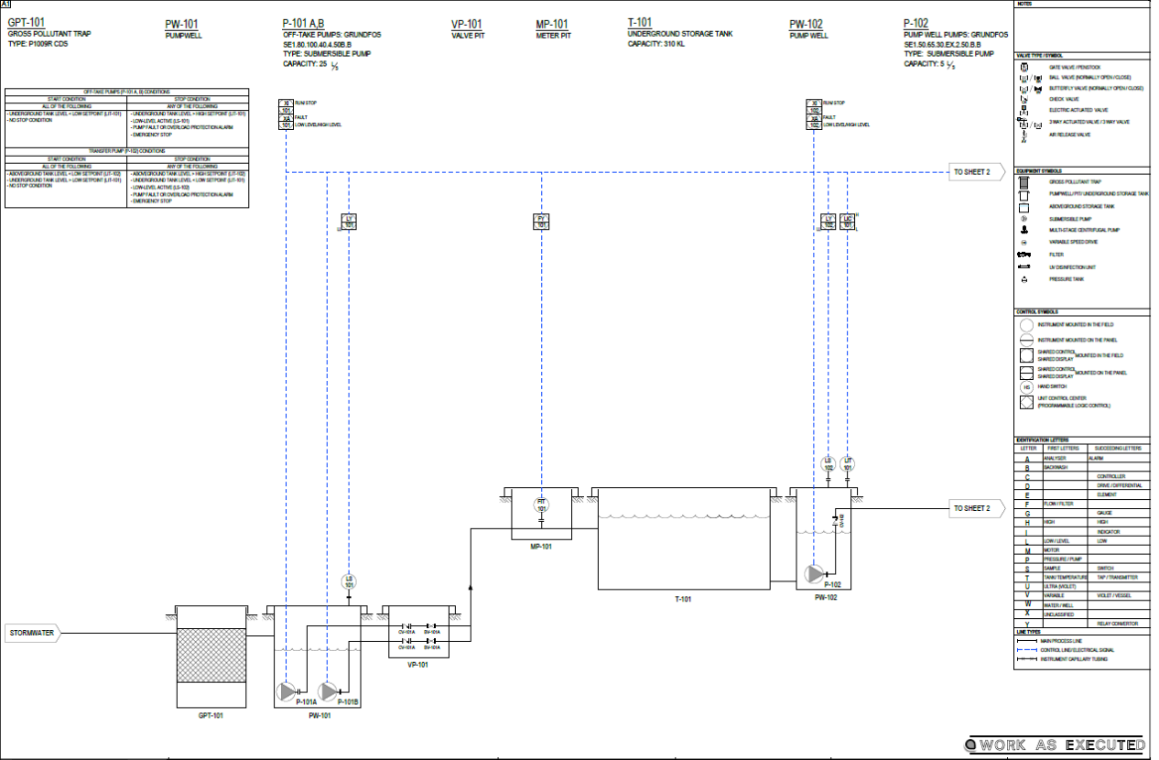

Slide 22
Recommendations
Design
Isolation valves should be on either side of components for easy maintenance and repairs.
contaminated land and geotechnical investigations during the design phase to mitigate the risk of unexpected rock and hazardous materials during excavation.
Diversion Pits
The design of diversion pits should account for hydraulic conditions to minimize the risk of blockages and reduce maintenance needs. Key factors to consider include:
Flow Dynamics: if velocity of water is slower at the offtake, sedimentation will occur
Isolation Mechanism: Incorporating an isolation device at the diversion pit to allow the system to be separated from the existing drainage network, facilitating maintenance
Accessibility: The positioning of the diversion pit should ensure ease of access, particularly if placed within a roadway. Given its critical role in a SWH system, proactive monitoring and maintenance are essential.

Slide 23
Recommendations
Gross Pollutant Trap (GPT) Design Considerations
Maintenance Accessibility: Ensure the GPT is accessible for vacuum truck operations, considering turning movements, load capacity, and general ease of access. Ideally, the design should minimize the need for traffic management during maintenance.
Full-Height Weirs: Incorporate full-height weirs to prevent gross pollutants from bypassing the GPT and entering the stormwater harvesting (SWH) system when the GPT reaches capacity.

Slide 24
Recommendations
Storage Design Considerations
Ventilation: Adequate ventilation should be provided for storage tanks to prevent airlocks during filling, which can reduce yield. Proper ventilation also facilitates confined space access if required.
Access for Maintenance: Below-ground storage tanks should have sufficient access points to support cleanout activities and routine maintenance.
Algal Bloom Prevention: Consider water body turnover frequency, treatment upstream of storages, and other mitigation of the risk of algal blooms.
Water Purging Capability: Storage systems should include provisions to purge stored water when necessary.
Groundwater Incursion Management: When designing impervious liners for open storage, assess the potential for groundwater incursion. Implement hold points and thorough quality assurance testing during construction to ensure liner effectiveness.

Slide 25
Recommendations
Advanced Treatment Facility Design Considerations
UV Globe Maintenance: Ensure sufficient space is allocated in tertiary treatment facilities for the removal and replacement of UV globes, allowing easy access for maintenance.
Equipment Storage: Designate space for storing essential equipment required to maintain the stormwater harvesting (SWH) system, ensuring efficient operation and servicing.
Operational Diagrams & Maps: Provide dedicated space for large-format (e.g., A0) operational diagrams and maps. These visual aids help system operators understand design intent and infrastructure locations more effectively.

Slide 26
Recommendations
Pumping and Control Design
Wet Wells: Include ways to manage contaminated stormwater.
Failure Mitigation Strategies: To reduce the impact of component failures, consider:
Preventing Accidental Drawdown: If a transducer fails, an open storage system should have a physical drawdown barrier integrated into the pumped offtake to maintain minimum design levels.
Overflow Safeguards: Ensure that underground storage includes an overflow mechanism to the drainage system to prevent excess pumping in case of transducer failure.
Safety Features: Deep pits, particularly pump pits requiring frequent inspection, should include safety grate platforms.
Potable Backup Supply: The system design must retain a direct potable connection to meet demand if a pump fails.

Slide 27
Recommendations
Coordination Between Superintendent and Designers: During construction, the superintendent should actively liaise with designers to ensure that any proposed changes align with the original design intent.
Product Specifications & Substitutions:
Construction specifications must clearly define functional requirements for products and brands (or approved equivalents where feasible).
Any product substitutions should be carefully monitored by the superintendent, with verification by the designer if there is uncertainty about suitability.
High-risk items include:
Bio-retention media
Tertiary treatment devices (e.g., screens and UV units)
Transducers and sensors

Slide 28
Recommendations
System Commissioning & Handover:
A detailed handover from the contractor to the operator must be conducted before commissioning the SWH system.
The handover session should involve all relevant staff responsible for the system’s operation and management.
Quality Assurance Documentation:
Develop comprehensive documentation during the design phase, incorporating hold points for critical components such as underground storage tanks.
For underground storage tanks, this should include:
Quality assurance certification for installation and impermeable liners
Compliance testing to verify the watertight integrity of the system

Slide 29
Recommendations
System Design for Reliability & Accessibility:
Prioritize a system that is easy to operate and understand while incorporating redundancy to ensure continued functionality if a component fails.
Accessibility should be a key consideration to allow for safe and efficient inspection and maintenance of critical system elements.

Slide 30
Thank you for attending!
Your feedback helps us improve future events!​
Tell us what you enjoyed​
Share what we can do better​
Contact us at Clearwater anytime to discuss training or capacity building needs.
info@clearwatervic.com.au

Slide 31
Thank you
Insert contact details here if required

